Slide 1

E-Commerce Recommendation System
DHARMI, URVAJ, KEERTHANA, SHWETA, SUNVID

Slide 2

Agenda
01
02
03
BUSINESS PROBLEM &
GOAL
DATA & INSIGHTS
METHODOLOGY &
MODEL
04
05
06
MARKETING
STRATEGIES
ECONOMIC VALUE
ROADMAP
1

Slide 3



INTRODUCTION
THE ERA OF PERSONAL SHOPPING EXPERIENCES
RECOMMENDATION ENGINES
35%
sales
70%
views
$1 Billion revenue
2
Notes:
Talk about what are recommendation engines
Click to show some examples of how recommendation engines helped some companies.

Slide 4
BUSINESS PROBLEM & GOAL
GOAL
21%
BUSINESS PROBLEM
$8.6M
SOLUTION
The e-commerce website lacks a personalized shopping experience for its customers which incurs opportunity cost with respect to higher sales within the relevant market.
Build a recommendation system based on past customer shopping behavior to provide a personalized shopping experience to them.​
Revenue by the end of the year
from $7.1M
Increase in Overall Sales
this year
3

Slide 5
BUSINESS PROBLEM & GOAL
GOAL
BUSINESS PROBLEM
$8.61M
SOLUTION
The e-commerce website lacks a personalized shopping experience for its customers which incurs opportunity cost with respect to higher sales within the relevant market.
Build a recommendation system based on past customer shopping behavior to provide a personalized shopping experience to them.​
Revenue by the end of the year
from $7.1M
4

Slide 6
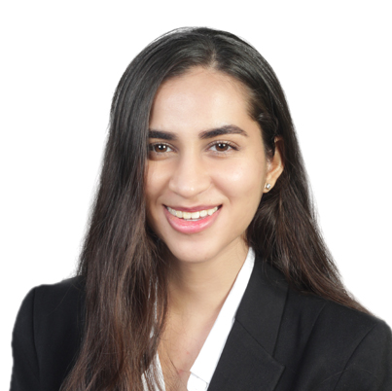
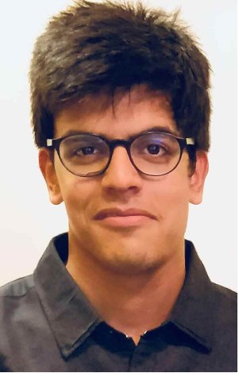
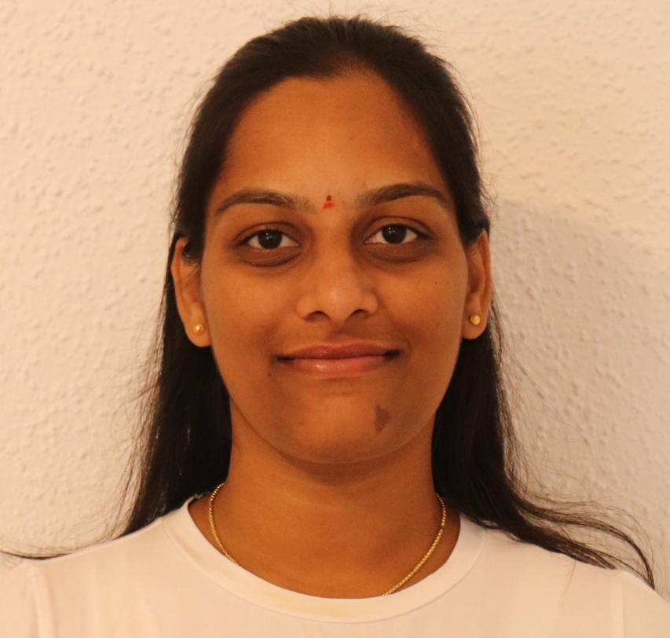


MEET OUR TEAM
DUKSS ANALYTICS
Aspect here
Aspect here
Aspect here
Aspect here
Aspect here
Aspect here
DHARMI
URVAJ
KEERTHANA
SHWETA
SUNVID
Customer Satisfaction
Manager
Customer Research
Analyst
Financial Analyst
Senior Data
Scientist
Marketing Analytics
Manager
5

Slide 7
DATA & INSIGHTS
$1.3M
IN SALES FROM
BUSINESSES
33,713 customer records.
30 book categories
Monetary values > 20K are institutes
Focusing analysis on individual customers.
$8.4M
In Sales
$7.1M
IN SALES FROM
INDIVIDUAL CUSTOMERS
6

Slide 8

DATA & INSIGHTS
80%
$1.3M
IN SALES FROM
BUSINESSES
Total revenue: $2.6M
Number of customers: 27000
$8.4M
In Sales
20%
$7.1M
IN SALES FROM
INDIVIDUAL CUSTOMERS
Total revenue: $4.6M
Number of customers: 6750
7

Slide 9
DATA & INSIGHTS
TOP BOOK CATEGORIES FOR INDIVIDUAL CUSTOMERS
History
$1.1M
Cont. History
$722K
Music
$626K
Health
$530K
Travel
Guides
$419K
Religion
$338K
8

Slide 10



METHODOLOGY – RFM ANALYSIS
KEY METRICS
RECENCY
FREQUENCY
MONETARY
How recently a customer has transacted with a brand
How much money they’ve spent on a brand’s products and services
How frequently they’ve engaged with a brand
9
Notes:
https://www.actioniq.com/blog/what-is-rfm-analysis/
License:
<a href="https://www.flaticon.com/free-icons/time" title="time icons">Time icons created by Freepik - Flaticon</a>

Slide 11
METHODOLOGY – RFM ANALYSIS
KEY METRICS & ALGORITHM
Assign every customer a rank on a scale of 4 for each metric using quartiles
RECENCY
FREQUENCY
MONETARY
4 – Best
How recently a customer has transacted with a brand
How much money they’ve spent on a brand’s products and services
How frequently they’ve engaged with a brand
3 – Good
2 – Not Good
1 - Worst
10
Notes:
https://www.actioniq.com/blog/what-is-rfm-analysis/
License:
<a href="https://www.flaticon.com/free-icons/time" title="time icons">Time icons created by Freepik - Flaticon</a>

Slide 12
METHODOLOGY – RFM ANALYSIS
CUSTOMER SEGMENTATION
KINGPIN
NEWBIES
Best Spenders
New Customers
R = 1, 2, 3, 4
F = 1, 2, 3, 4
M = 4
R = 4
F = 1, 2
M = 1, 2
10.14%
7.91%
LORD
VILLAGER
Best Customers
Low Spenders
R = 4
F = 4
M = 4
25.58%
R = 1, 2, 3, 4
F = 1, 2, 3, 4
M = 1, 2
7.39%
CUSTOMER SEGMENTS BASED ON RFM COMBINATION
EXAMPLES: 444, 213
KNIGHT
CHAMPION
Loyal customers
3.4%
Promising Loyal customers
R = 3, 4
F = 3, 4
M = 3, 4
R = 3, 4
F = 3, 4
M = 3, 4
16.97%
TRADER
2.69%
SQUIRE
Less recent, big spenders
25.92%
Potential loyal customers
R = 1, 2
F = 1, 2, 3, 4
M = 4
R = 1, 2, 3, 4
F = 2, 3
M = 2, 3
11

Slide 13
METHODOLOGY – RFM ANALYSIS
TARGET CUSTOMERS
KINGPIN
NEWBIES
Best Spenders
New Customers
R = 1, 2, 3, 4
F = 1, 2, 3, 4
M = 4
R = 4
F = 1, 2
M = 1, 2
10.14%
7.91%
LORD
VILLAGER
Best Customers
Low Spenders
R = 4
F = 4
M = 4
25.58%
R = 1, 2, 3, 4
F = 1, 2, 3, 4
M = 1, 2
7.39%
CUSTOMER SEGMENTS BASED ON RFM COMBINATION
EXAMPLES: 444, 213
KNIGHT
CHAMPION
Loyal customers
3.4%
Promising Loyal customers
R = 3, 4
F = 3, 4
M = 3, 4
R = 3, 4
F = 3, 4
M = 3, 4
16.97%
TRADER
2.69%
SQUIRE
Less recent, big spenders
25.92%
Potential loyal customers
R = 1, 2
F = 1, 2, 3, 4
M = 4
R = 1, 2, 3, 4
F = 2, 3
M = 2, 3
12

Slide 14



MODELS USED WITH RFM ANALYSIS
BASED ON CORRELATION BETWEEN USERS & ITEMS
COLLABORATIVE FILTERING
CONTENT BASED FILTERING
Read by both users
SIMILAR USERS
Similar books
Recommended
Recommend similar user’s interests to customer
13
Notes:
Hybrid filtering : Combination of above

Slide 15


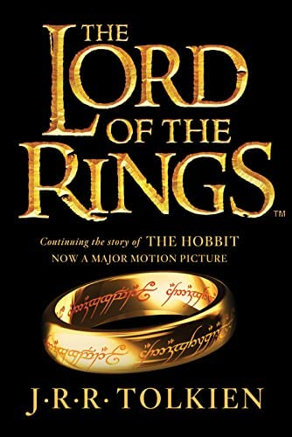





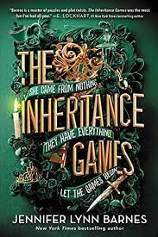
MARKETING STRATEGIES
X
THE BOOK PALACE
HI BRYAN
HOME
CART
CATEGORIES
ITEMS FOR YOU
$9.99
$9.99
$5.99
$7.99
CUSTOMERS LIKE YOU BOUGHT
$9.99
$5.99
$9.99
$8.99
14
Notes:
Recommended for signed up users

Slide 16





MARKETING STRATEGIES
X
THE BOOK PALACE
HI BRYAN
HOME
CART
CATEGORIES
PRODUCTS RELATED TO THIS ITEM
$9.99
$9.99
$5.99
$7.99
FREQUENTLY BOUGHT TOGETHER
$9.99
$5.99
$9.99
$8.99
15
Notes:
This will appear when an item is chosen. Suppose a mystery book is being looked at, then these show up. They also appear on the checkout page.

Slide 17


MARKETING STRATEGIES
X
THE BOOK PALACE
HI BRYAN
HOME
CART
CATEGORIES
MOST POPULAR ITEMS
$9.99
$9.99
$5.99
$7.99
THE BOOK PALACE
HOME
CART
CATEGORIES
16
Notes:
Based on the algorithm currently being used, this will appear on every page.

Slide 18












MARKETING STRATEGIES
TARGETTED MESSAGING
KNIGHT – LOYAL CUSTOMERS
ALL CUSTOMERS
Loyalty programs – Gold, Silver Platinum customers
Early access reward based on level of loyalty program the customer is in
Email Marketing – personalized offers/programs based on customer segment
KINGPIN – BEST SPENDERS
Convey scarcity or urgency of product stock
Rewards program
Recommend rare/luxury book items
SQUIRE – POTENTIAL LOYAL CUSTOMERS
Loyalty programs, Rewards programs
Referral programs
Ask for reviews and surveys
VILLAGER – LOW SPENDERS
Discounts, Promotions
Rewards programs, loyalty programs
Referral programs
17
Notes:
https://www.wordstream.com/blog/ws/2019/07/18/loyalty-marketing

Slide 19
ECONOMIC VALUE
SEGMENT | Current Revenue | New Revenue | Increase in Revenue |  | Total Revenue
 |  |  | INCREASED BY | % INCREASE | % INCREASE | TOTAL
WITHOUT RECOMMENDATION SYSTEM
Top 20% customers | $4.6M |  | $0.71M | 10% | 10% | $7.81M
Remaining 80% customers | $2.5M
WITH RECOMMENDATION SYSTEM – 1st YEAR
Top 20% customers | $4.6M | $5.98M | $1.38M | 30% | 22.7% | $8.61M
Remaining 80% customers | $2.5M | $2.63M | $0.13M | 5%
WITH RECOMMENDATION SYSTEM – 2nd YEAR
Top 20% customers | $5.98M | $7.18M | $1.2M | 20% | 17% | $10.08M
Remaining 80% customers | $2.63M | $2.9M | $0.26M | 10%
18

Slide 20


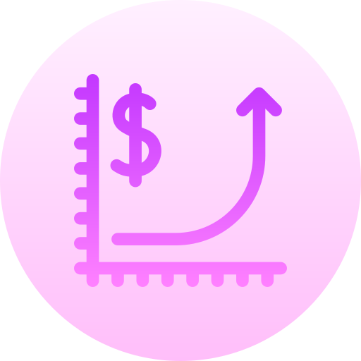


ROADMAP
Suggest personalized recommendations via email, text messages to customers
Use geographical data to further make recommendations based on location
Implement the recommendation model with User Acceptance tests
Implement promotional offers to attract new customers
To increase revenue, provide targeted ad space for some products
19
Notes:
1. Implement the recommendation model with User Acceptance tests within 2 months.
2. Suggest personalized recommendations via email or text messages to customers. 3. Implement promotional offers to attract new customers.
4. Use geographical data to further make recommendations based on location.
5. ?

Slide 21
THANK
YOU!
20

